Slide 1
Land Use Land Cover Classification using Machine Learning Algorithms and Remote Sensing
Mentor: Mr. Hemanth Singh Pokhariya
Name: Kanuri Pranay
Section: AI&DS
Uni Roll No:2019417

Slide 2
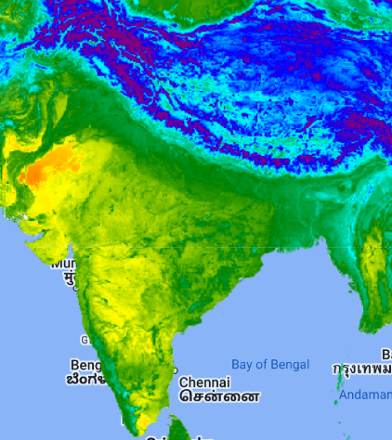
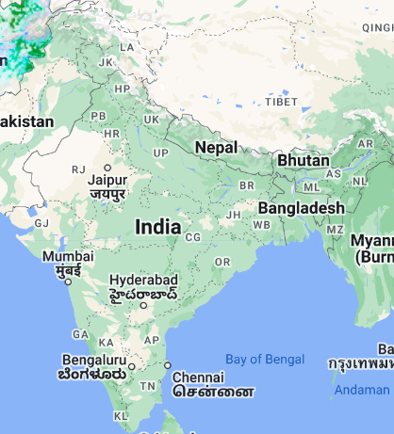
What is Land Use Land Cover ?
Land use is commonly defined as a series of operations on land, carried out by humans, with the intention to obtain products and/or benefits through using land resources.
Land cover is commonly defined as the vegetation (natural or planted) or man-made constructions (buildings, etc.) which occur on the earth surface. Water, ice, bare rock, sand and similar surfaces also count as land cover.

Slide 3
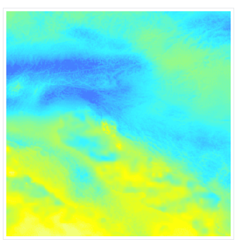
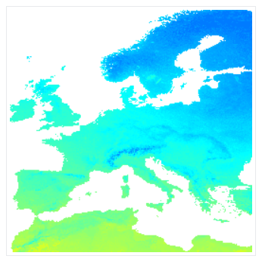
Four types of Datasets are used in preparation of this project.
* OpenLandMap Precipitation Monthly
ee.Image("OpenLandMap/CLM/CLM_PRECIPITATION_SM2RAIN_M/v01")
Monthly precipitation in mm at 1 km resolution based on SM2RAIN-ASCAT 2007-2018, IMERG, CHELSA Climate, and WorldClimate.
* OpenLandMap Long-term Land Surface Temperature Daytime Monthly Median
ee.Image("OpenLandMap/CLM/CLM_LST_MOD11A2-DAY_M/v01")
Land Surface Temperature daytime monthly mean value

Slide 4
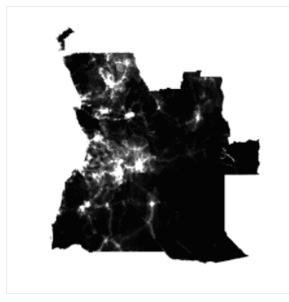
WorldPop Global Project Population Data: Estimated Residential Population per 100x100m Grid Square
ee.ImageCollection("WorldPop/GP/100m/pop")
Global high-resolution, contemporary data on human population distributions are a prerequisite for the accurate measurement of the impacts of population growth, for monitoring changes, and for planning interventions. The WorldPop project aims to meet these needs through the provision of detailed and open access population distribution datasets built using transparent and peer-reviewed approaches.

Slide 5
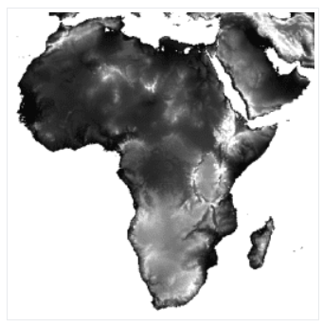
NASADEM: NASA NASADEM Digital Elevation 30m
ee.Image("NASA/NASADEM_HGT/001")
NASADEM is a reprocessing of SRTM data, with improved accuracy by incorporating auxiliary data from ASTER GDEM, ICESat GLAS, and PRISM datasets.
The most significant processing improvements involve void reduction through improved phase unwrapping and using ICESat GLAS data for control.

Slide 6
Methodology
Precipitation Data Processing: Sum precipitation data and visualize it on the map as a 'Rain' layer with a specified color palette.
LST Label Preparation: Calculate the mean of Land Surface Temperature (LST), convert it to Celsius, and visualize it on the map as an 'LST' layer with a specified color palette.
Population Data Processing: Filter and sort population data, selecting the first image within a specified geometry, and visualize it on the map as a 'Population' layer with a specified color palette.
Elevation Data Visualization: Select elevation data and visualize it on the map as an 'Elevation' layer with a specified color palette.
Combine Data: Create a composite image by combining precipitation, LST, population, and elevation images, and update the mask based on population data.

Slide 7
6) Data Sampling: Randomly sample the combined data, add a random column, and visualize it on the map as a 'Sample' layer.
7) Train-Test Split: Split the sampled data into training and testing sets based on a random column.
8) Random Forest Regression: Perform Random Forest Regression using training data, with LST as the target variable and precipitation, elevation, and population as predictors.
9) Prediction: Make LST predictions for the entire dataset and visualize the results on the map as an 'LST Prediction' layer.
10) Accuracy Assessment: Classify the test data using the trained model and visualize the accuracy through a scatter chart comparing actual and predicted LST values.

Slide 8
Smile Random Forest Regression is used
ee.Classifier.smileRandomForest(numberOfTrees, variablesPerSplit, minLeafPopulation, bagFraction, maxNodes, seed)
Arguments:
numberOfTrees (Integer):
The number of decision trees to create.
variablesPerSplit (Integer, default: null):
The number of variables per split. If unspecified, uses the square root of the number of variables.
minLeafPopulation (Integer, default: 1):
Only create nodes whose training set contains at least this many points.
bagFraction (Float, default: 0.5):
The fraction of input to bag per tree.
maxNodes (Integer, default: null):
The maximum number of leaf nodes in each tree. If unspecified, defaults to no limit.
seed (Integer, default: 0):
The randomization seed.
Returns: Classifier

Slide 9
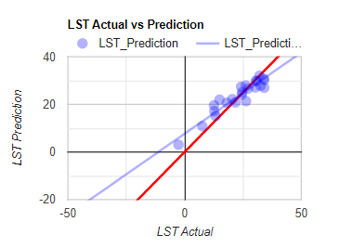
Regression Results And Scatterplot
Number of tress taken 50
elevation: 2528593.634869188
pop: 2667599.693796736
rain: 2812500.773086691

Slide 10
Discussion
In this project we used number of satellite data to gain insights on land surface temperature. Using smile Random Forest machine learning algorithm over India and parts surrounding countries and can be seen that results i.e. prediction are considerably good and there is more room to improve it.

